Slide 1
ONLINE FOOD DELIVERY APP
227 .NET -RLL

Slide 2
Team 6
Shyam Sunder S 2529524
Bagerathi S 2528023
Ankit Kumar Singh 2530063
Gayathri S S 2529151
Mallugari Sravani 2527811
Aneeshraj PB 2530053

Slide 3
Abstract
In this project, we have created a .NET Web application called HungerHunt, an Online Food Delivery System. using ASP .NET MVC.
Here both Admin and Customer side are feasible where customer can register and login and the Admin can monitor and control various features of the app.
The Admin can perform CRUD operations for the food items with respect to each individual Restaurant .

Slide 4
Introduction
The "Online Food Delivery System" has been developed to override the problems prevailing in the practicing manual system Moreover, this system is designed for the particular need of the company to carry out operations in a smooth and effective manner.
The application is reduced as much as possible to avoid errors while entering the data. It also provides error message while entering invalid data. Thus, by this all it proves it is user-friendly.
Every organization, whether big or small, has challenges to overcome and managing the information of Category, Food Item, Order, Payment, Confirm Order.

Slide 5
Objective
The Main objective is to create a Dynamic and responsive .NET Web application that helps in forming a bridge between the Restaurants and the consumers thus allowing to order food online.
A bug free , secure and an easily maintainable platform convenient for both the admin and the consumer is targeted
MyDelivery

Slide 6
01
02
03
04
Front-End
Server Side
Data Access Layer
Database
Tools And Languages
Visual Studio
HTML
CSS
BOOTSTRAP
ASP .NET MVC
Entity Framework
ADO .NET
MS SQL Server

Slide 7
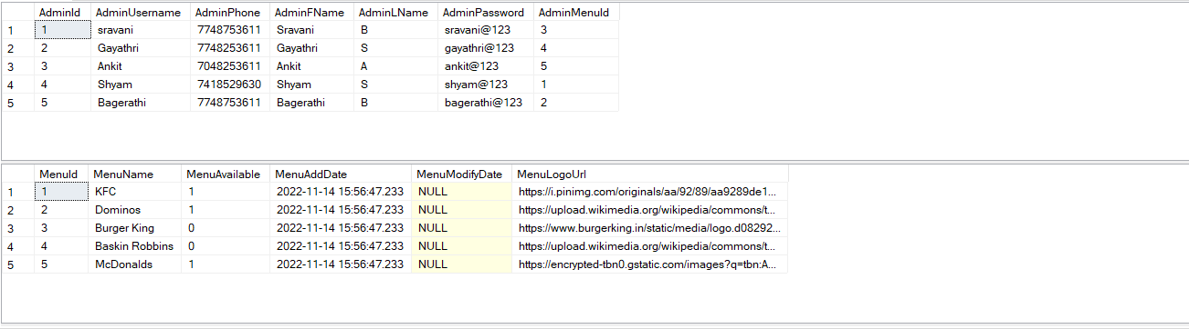
Admin and Menu Table

Slide 8
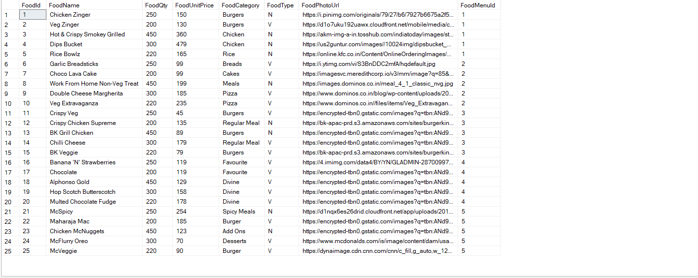
Food Table

Slide 9
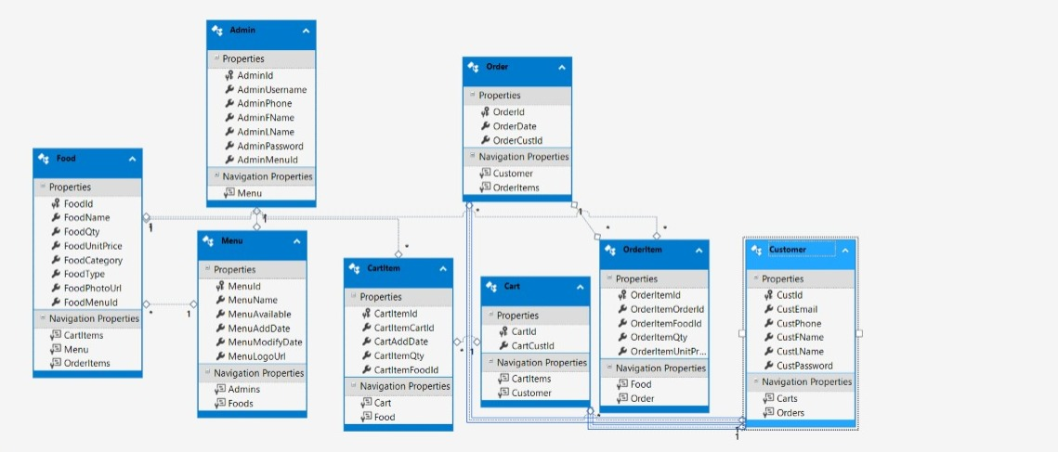
Database Schema Design
W
Notes:
8 tables

Slide 10
FLOW OF APPLICATION
Admin
Login
user
Home Page
Admin Actions(add/delete/view)
User Actions
Restaurant Details
Restaurant Data
Food Item List
Manage Items
Add To Cart
Schedule
Customer Orders
Log out

Slide 11
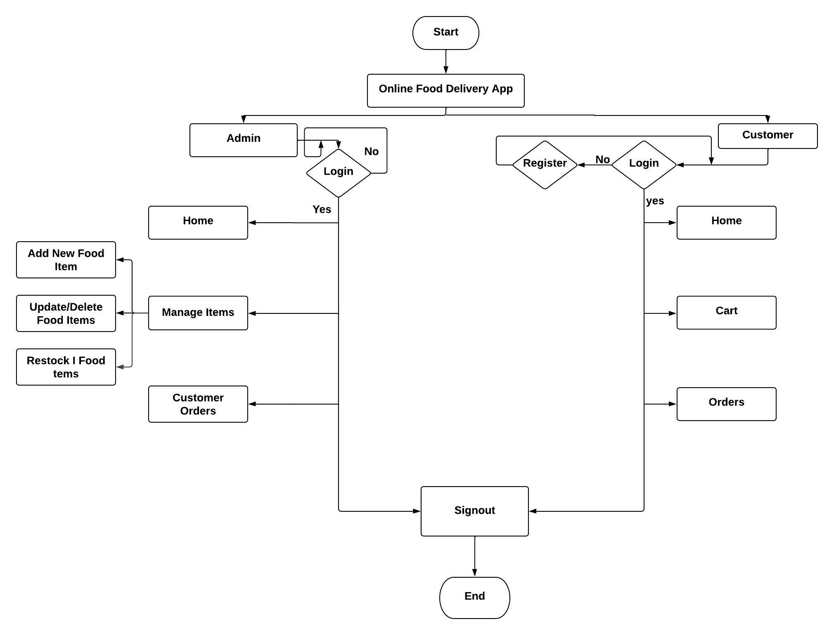
Flowchart

Slide 12
Output Screenshots Admin Side

Slide 13
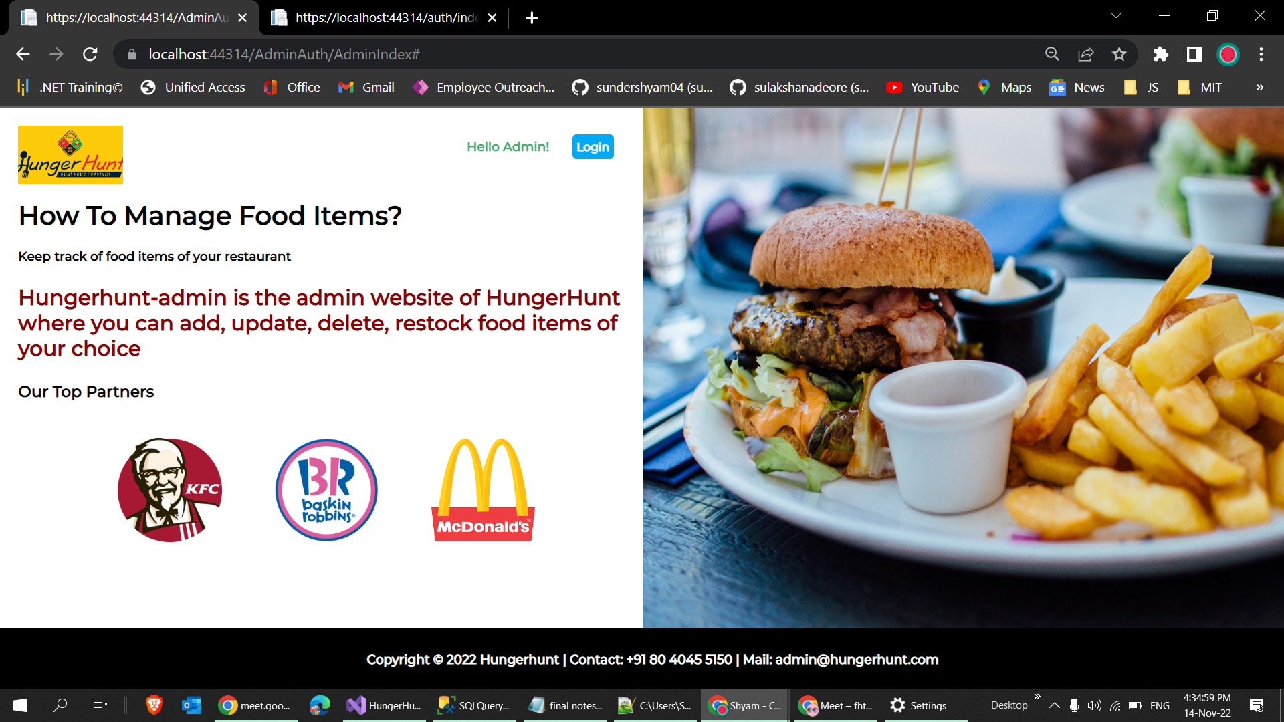
Admin Page

Slide 14
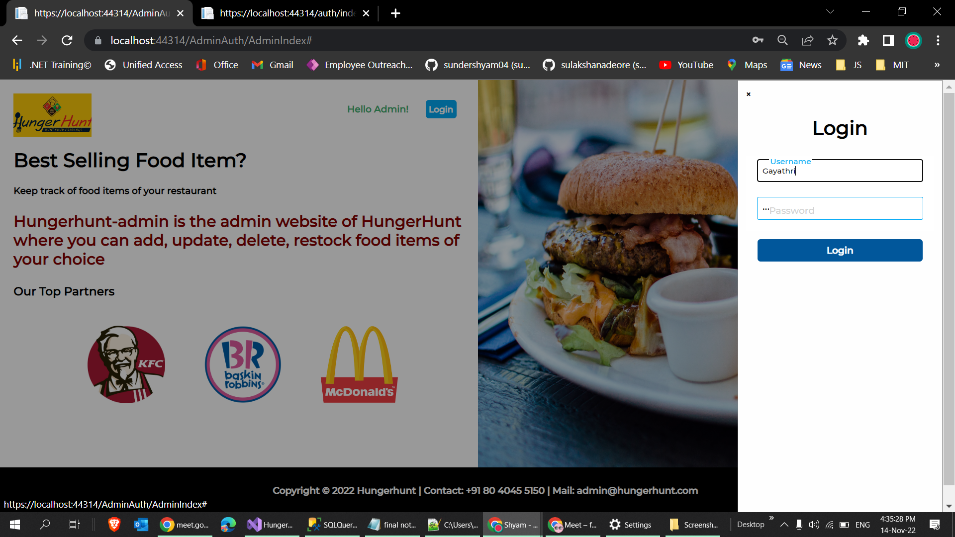
Admin Login

Slide 15
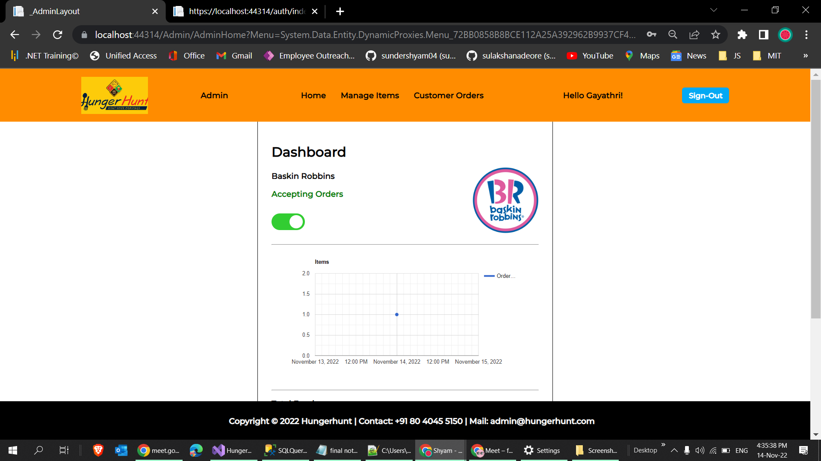
Home Page

Slide 16
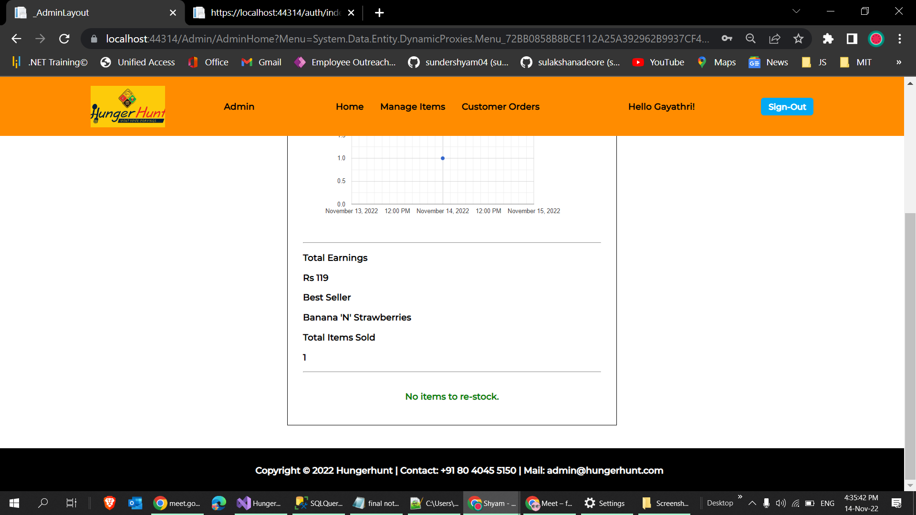

Slide 17
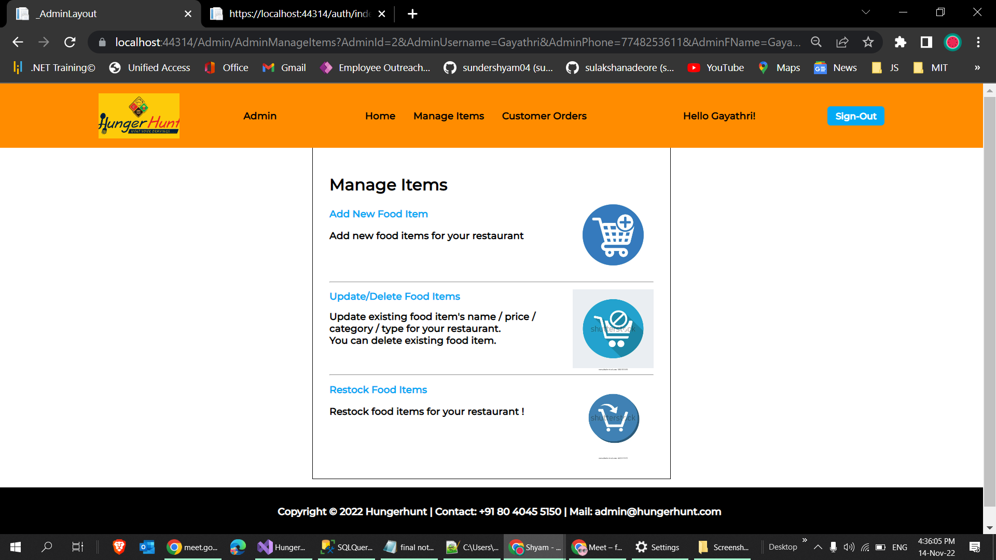
Manage Items Page

Slide 18
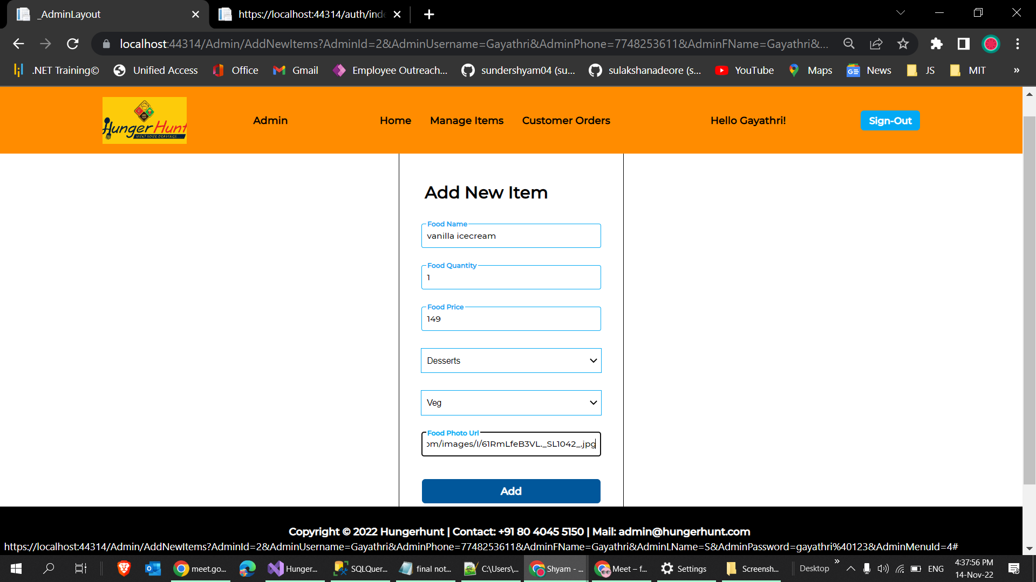
Adding an Item

Slide 19
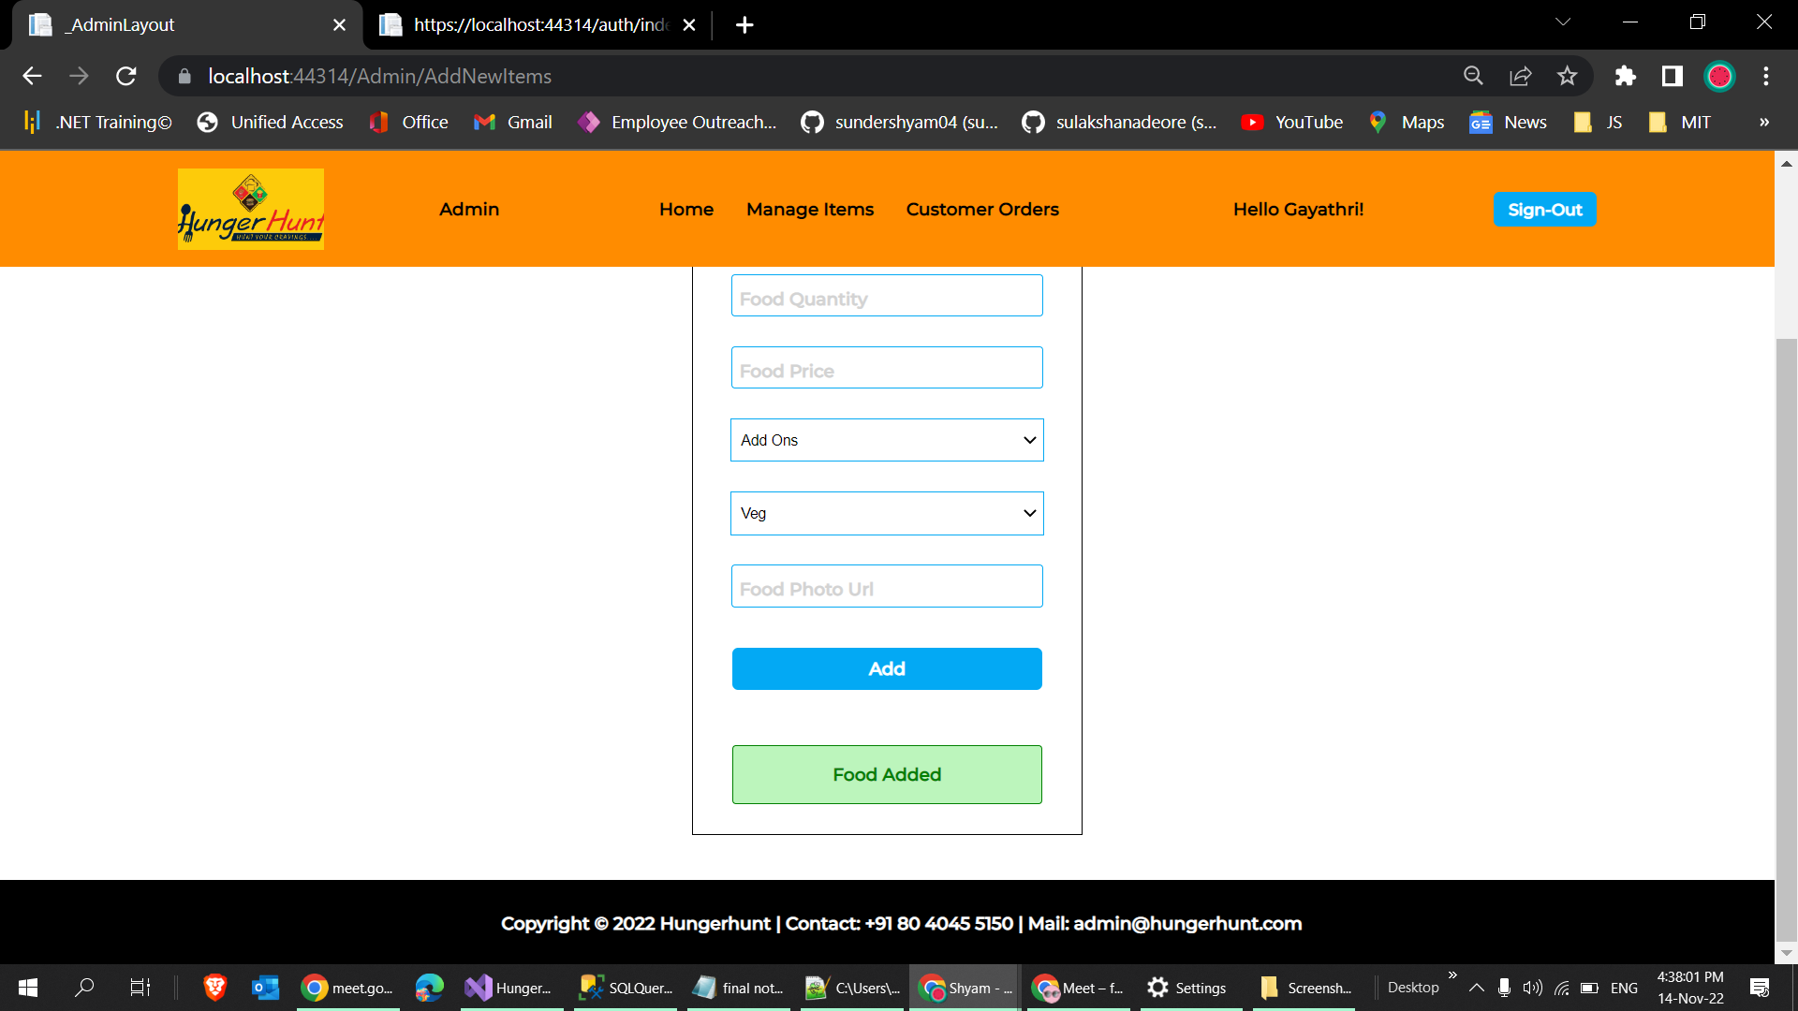

Slide 20
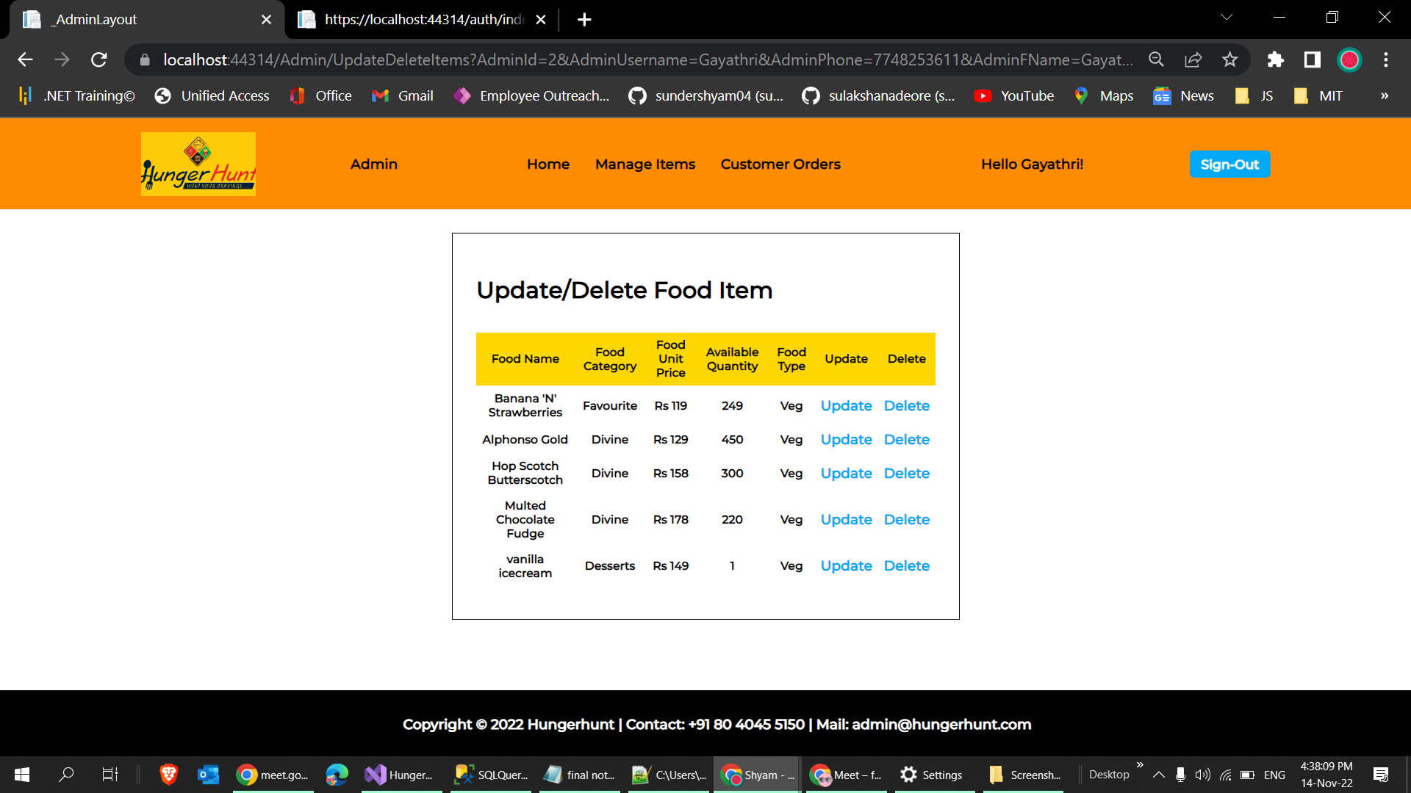
Updating and Deleting an Item

Slide 21
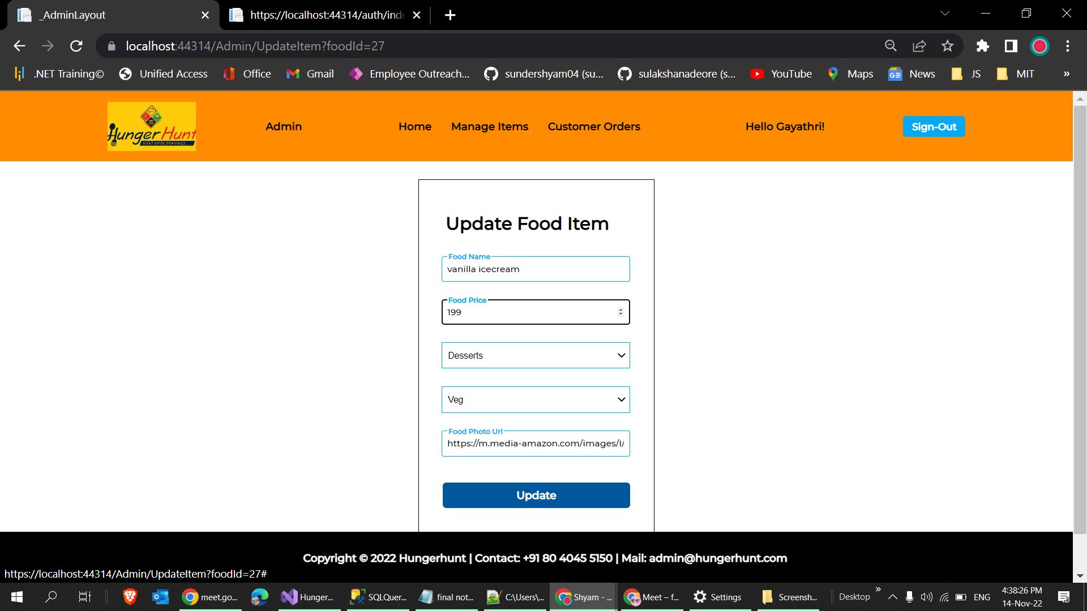
Updating an item

Slide 22
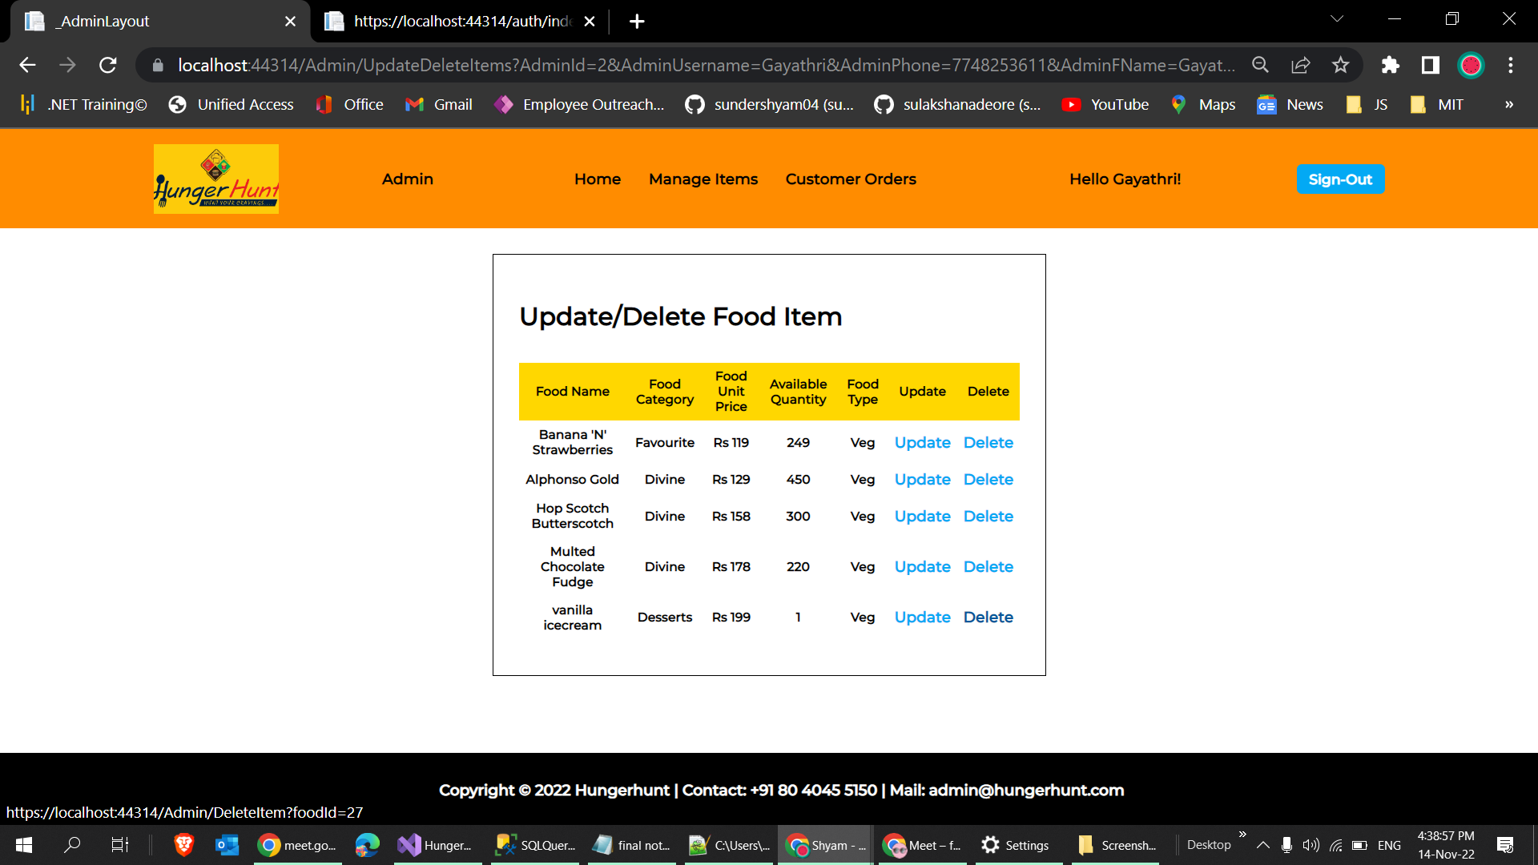

Slide 23
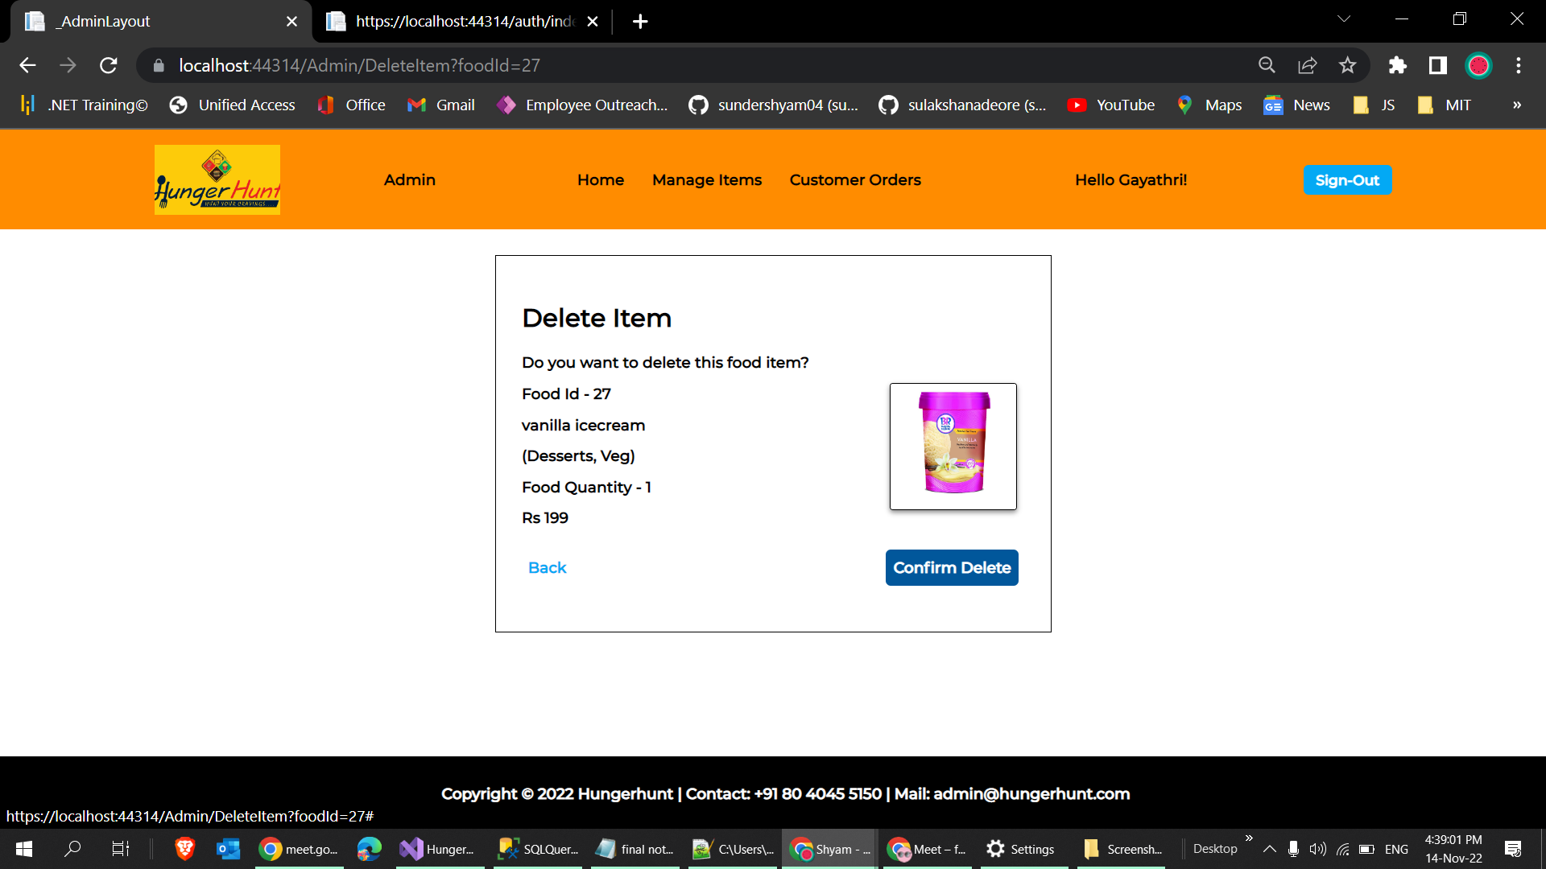
Deleting an existing item

Slide 24
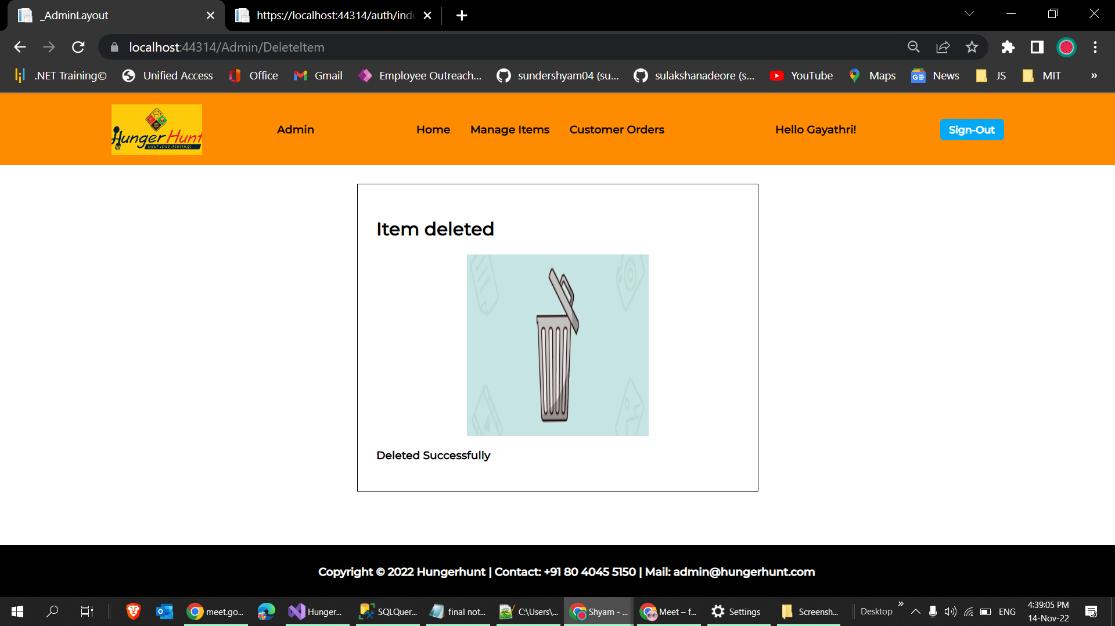

Slide 25
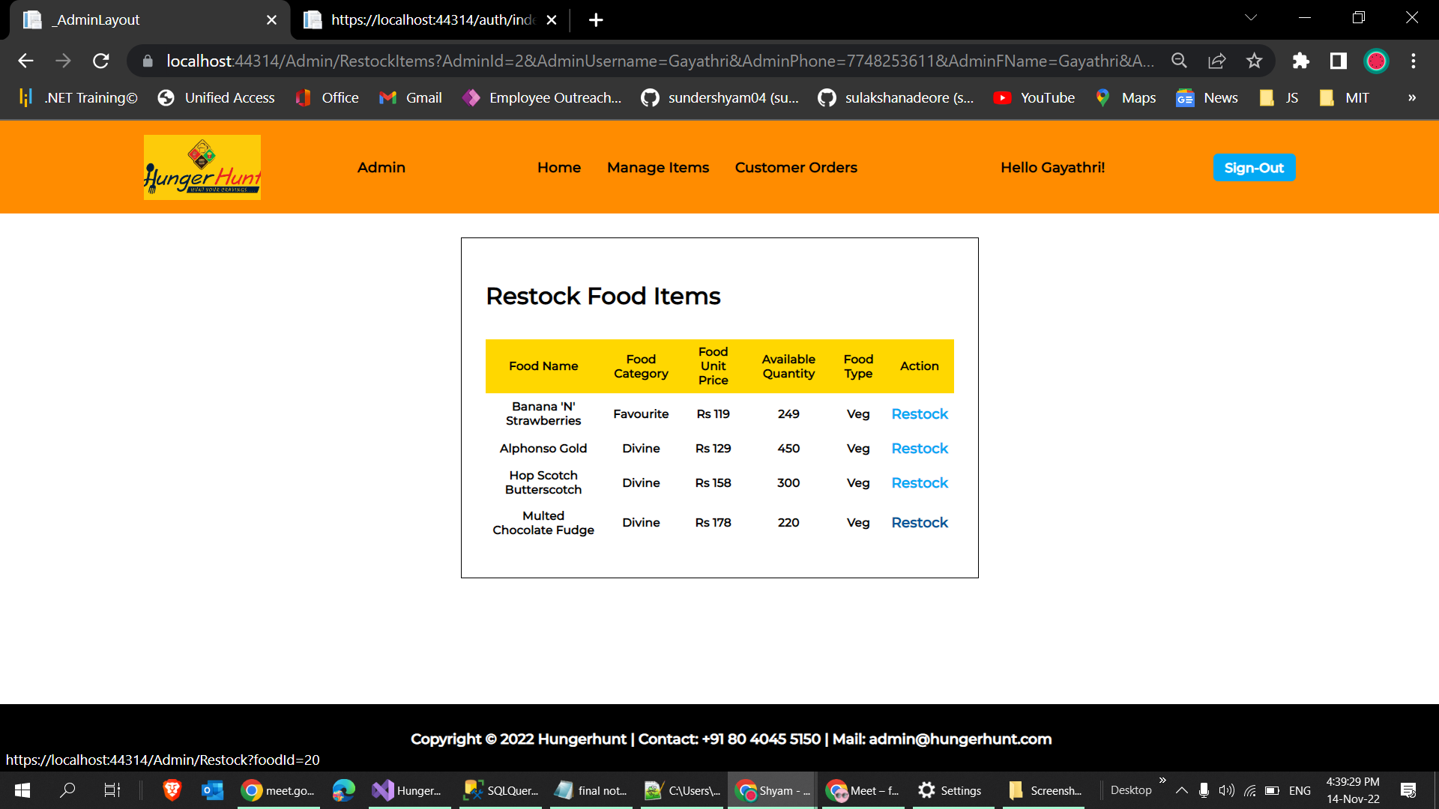
Restocking an item

Slide 26
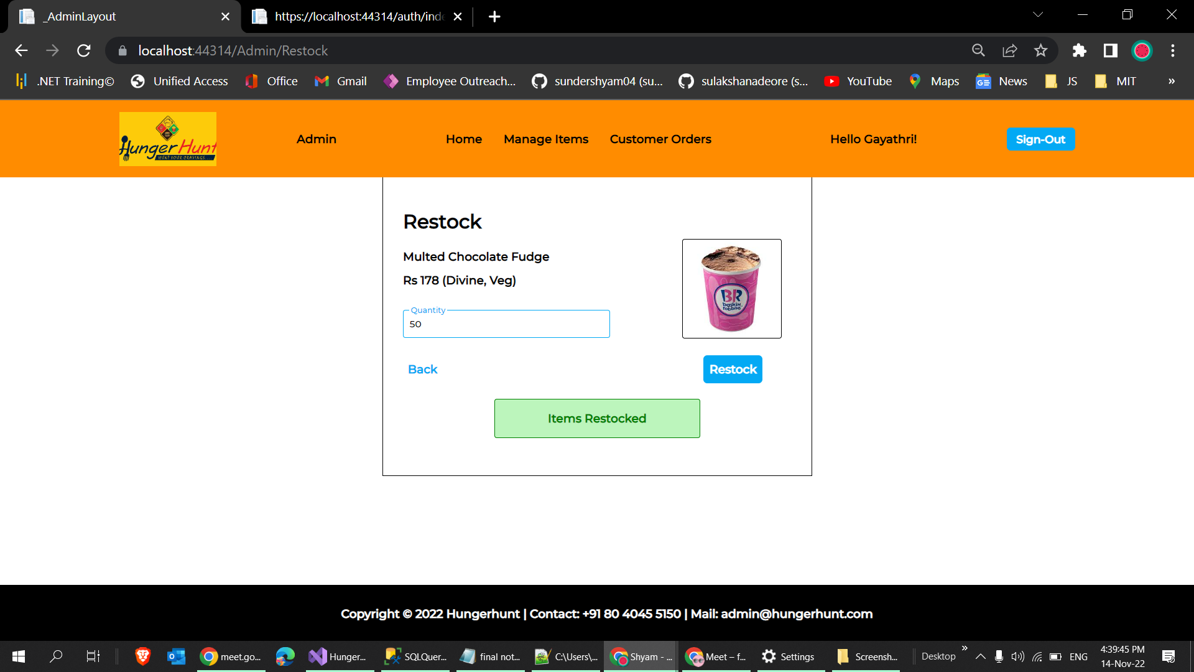

Slide 27
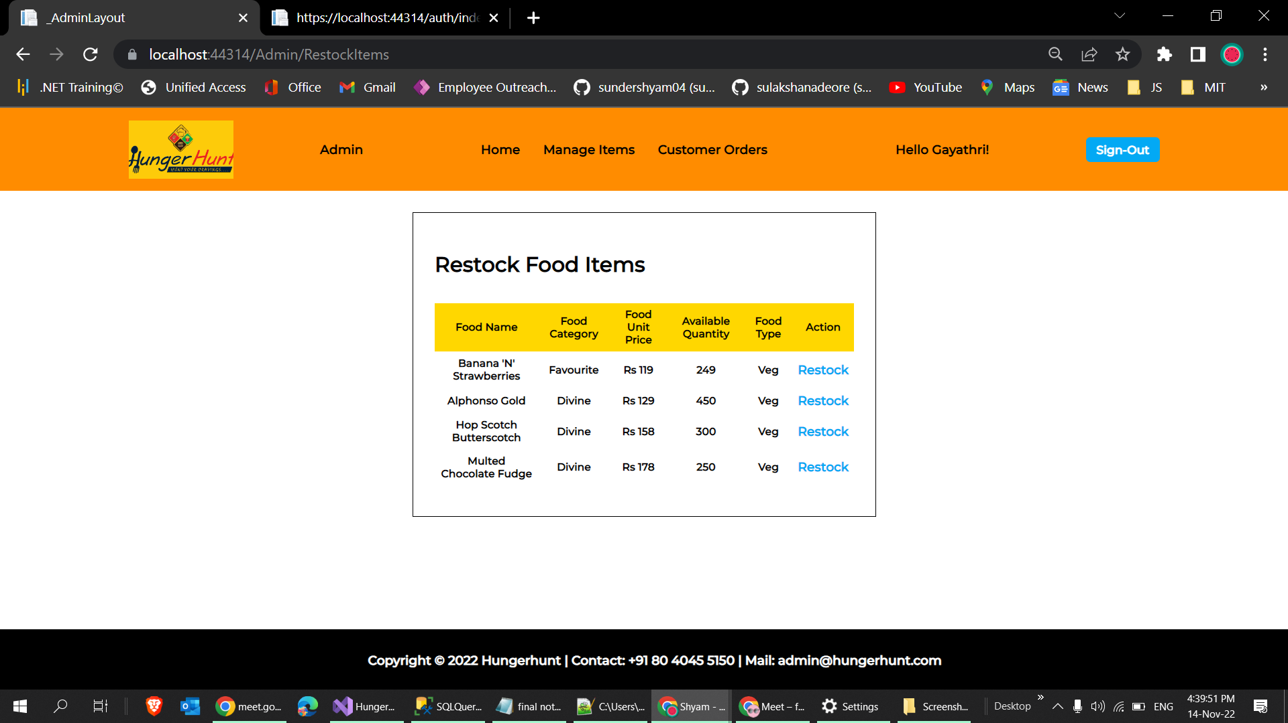
Restocking an Item

Slide 28
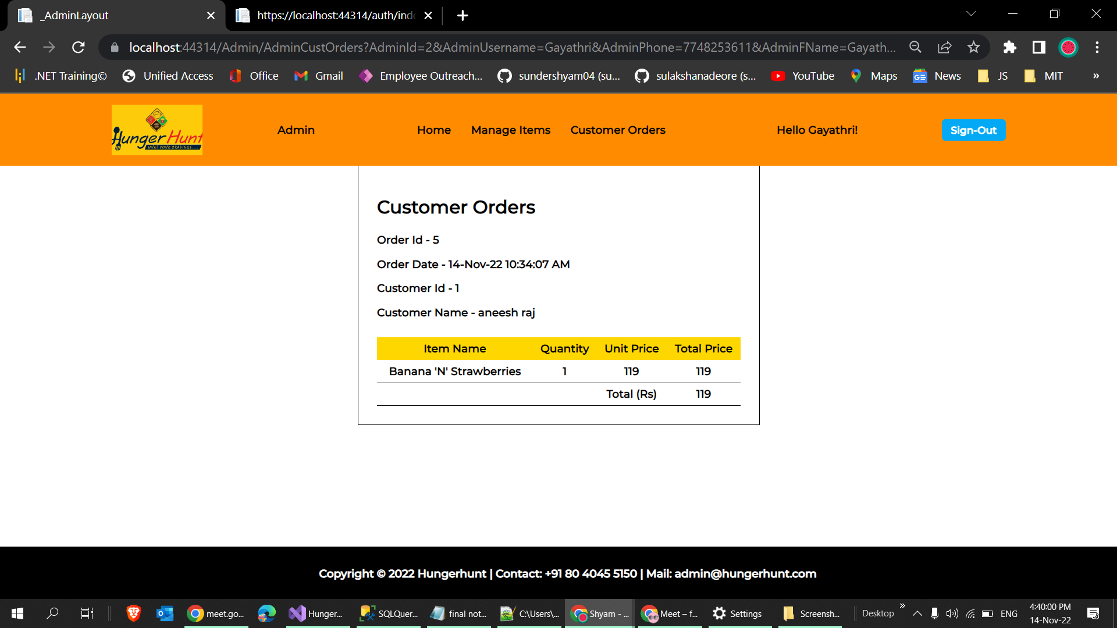
Customer Order Page

Slide 29
Customer Side

Slide 30
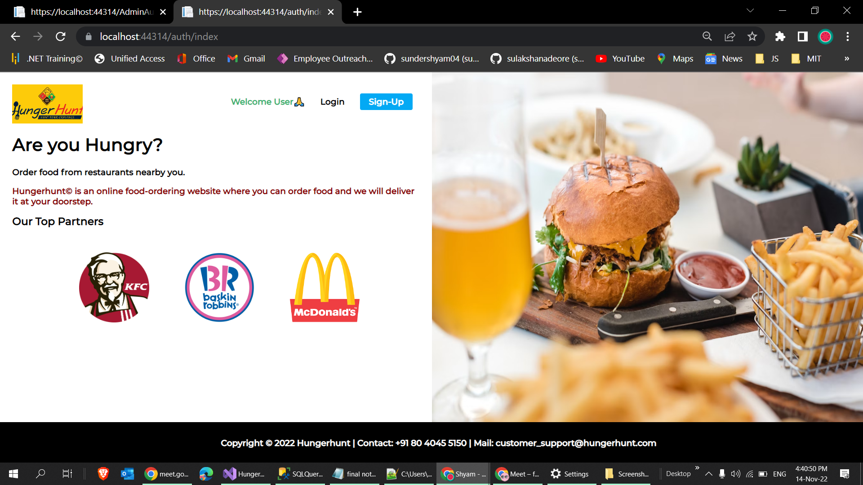
Welcome Page

Slide 31
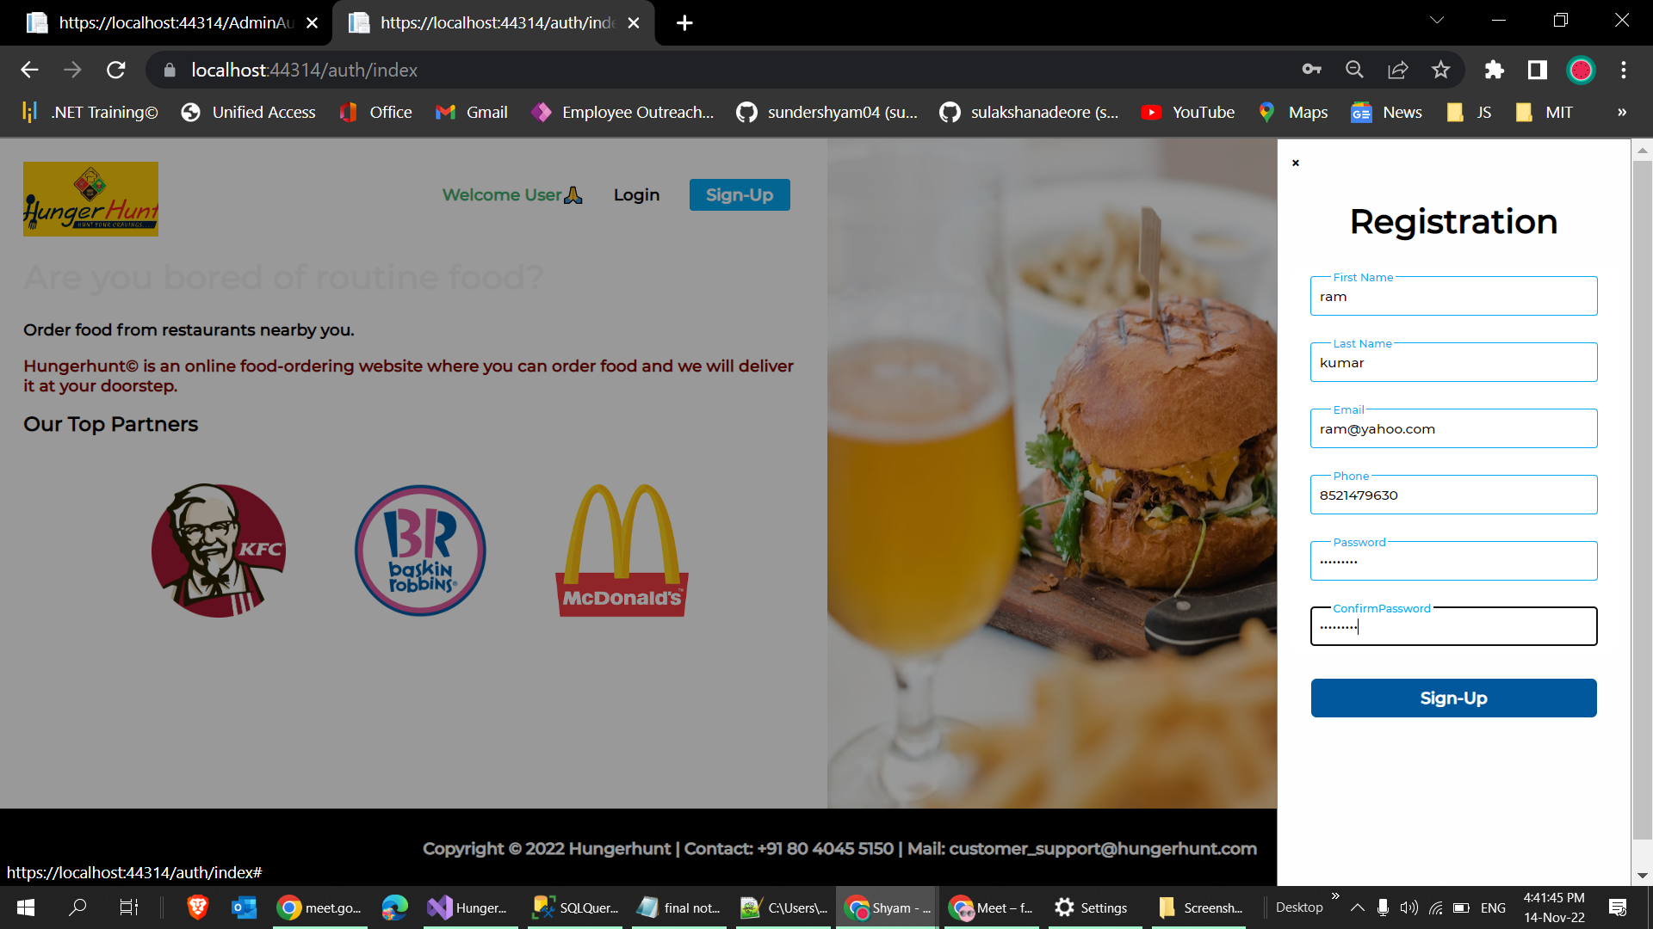
Sign-Up Page

Slide 32
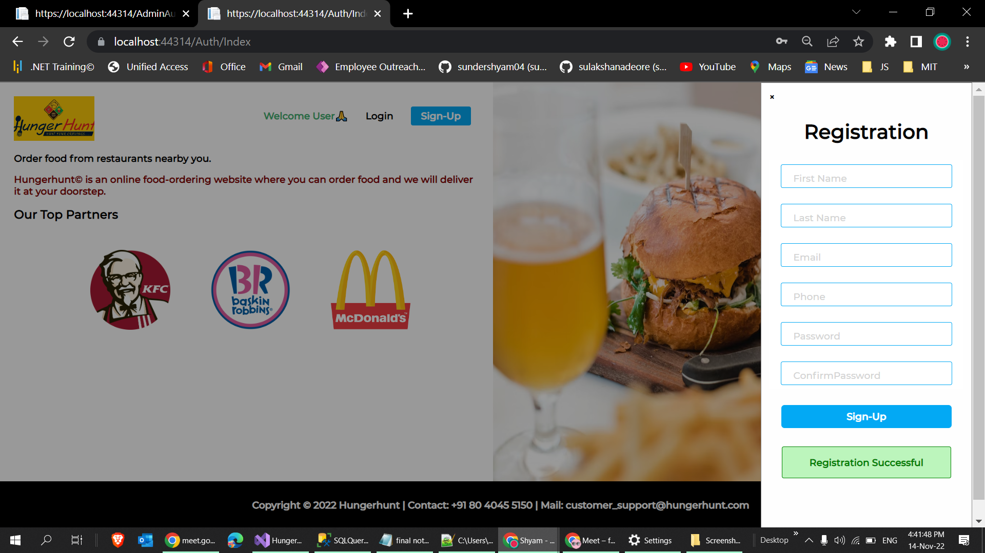

Slide 33
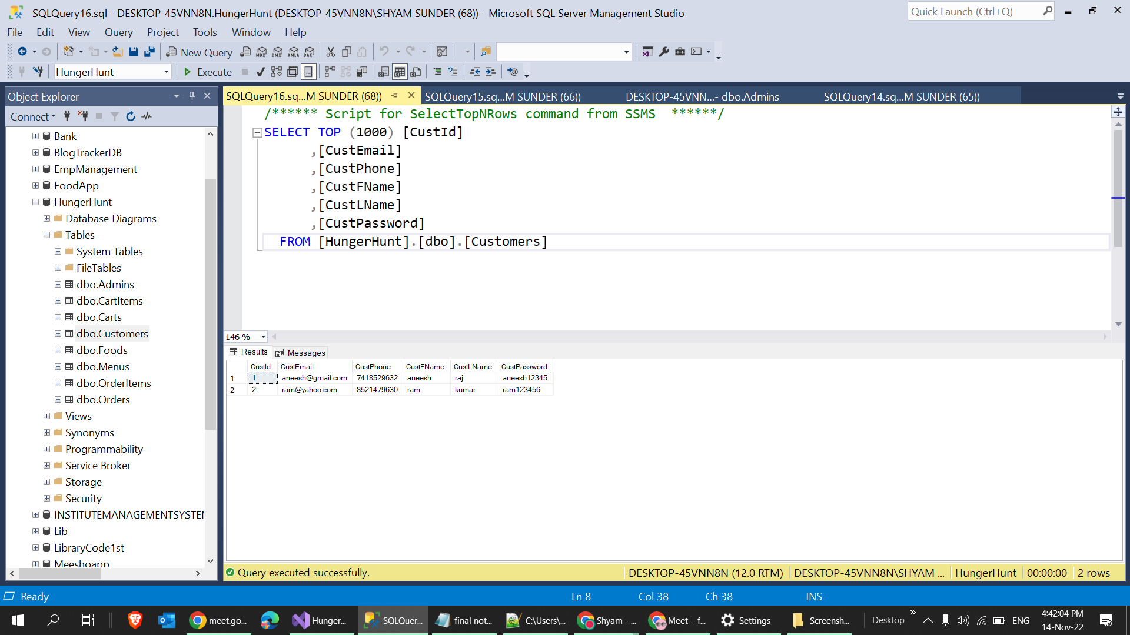
Database Credential Details

Slide 34
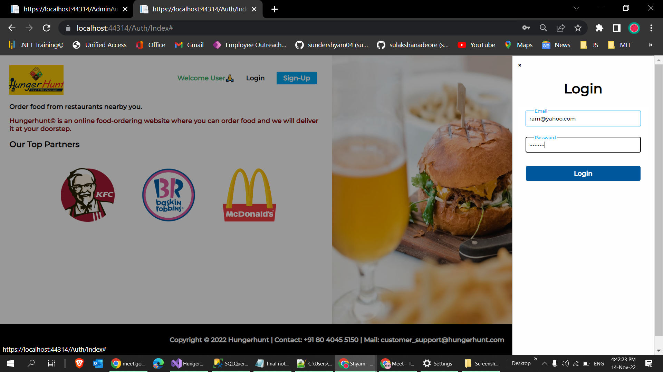
Login Page

Slide 35
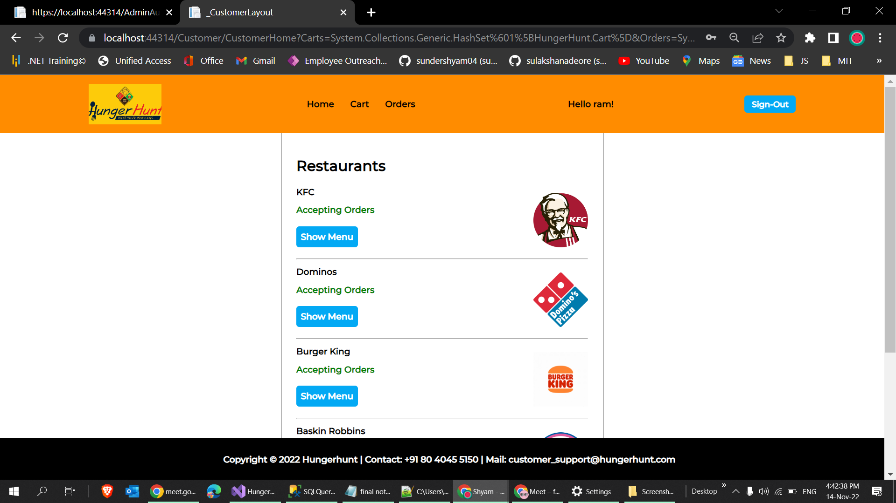
Home Page

Slide 36
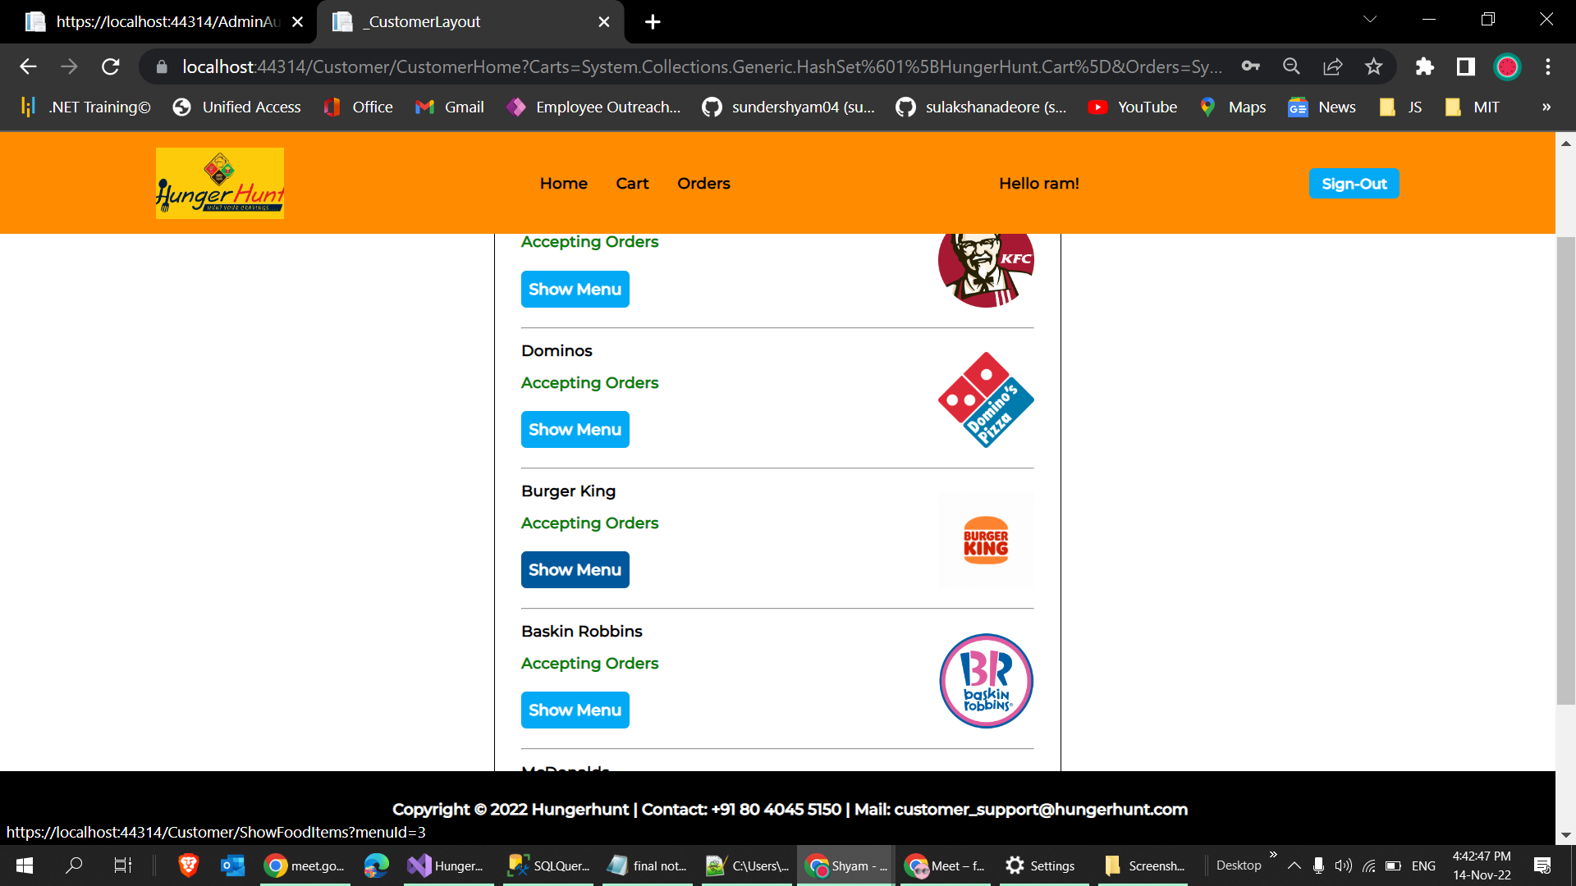

Slide 37
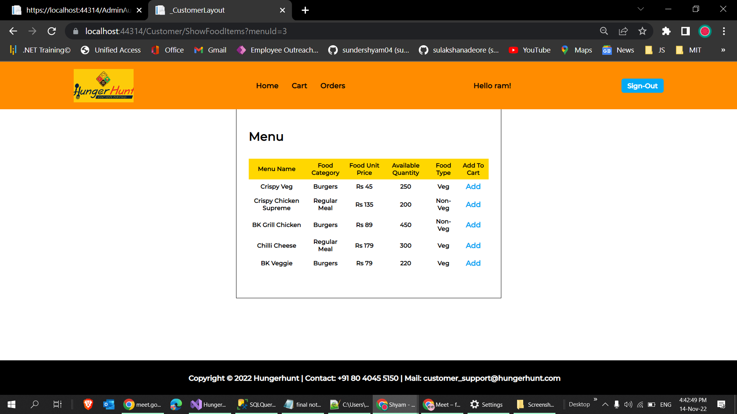
List of items

Slide 38
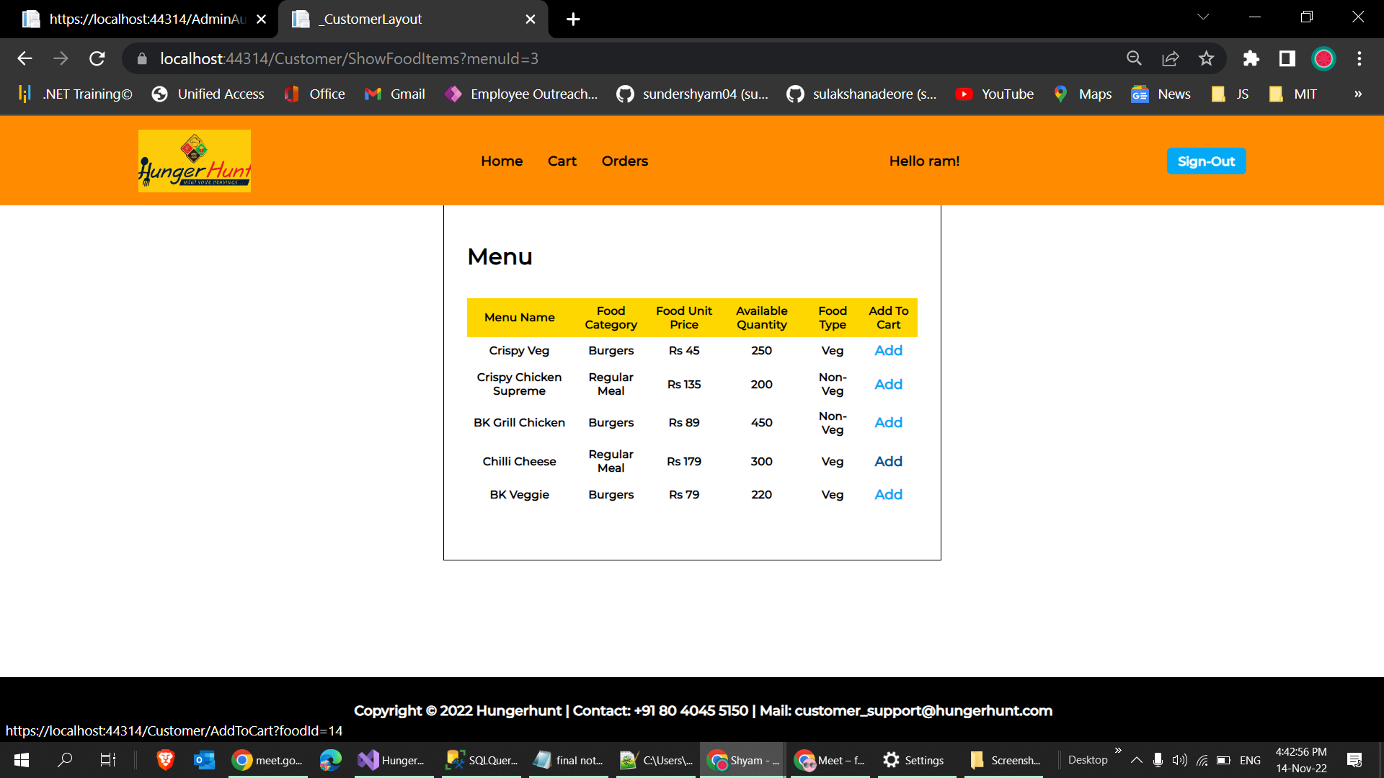

Slide 39
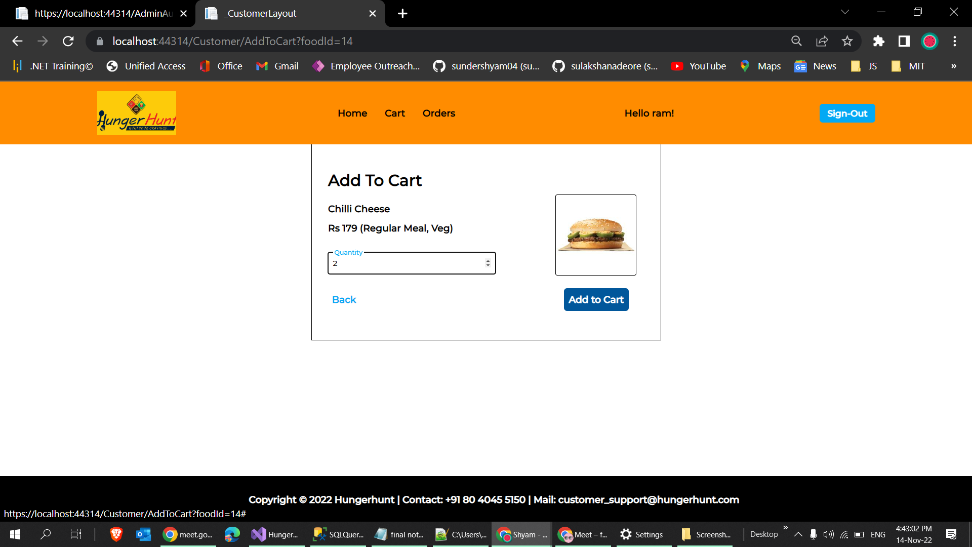
Adding an item to cart

Slide 40
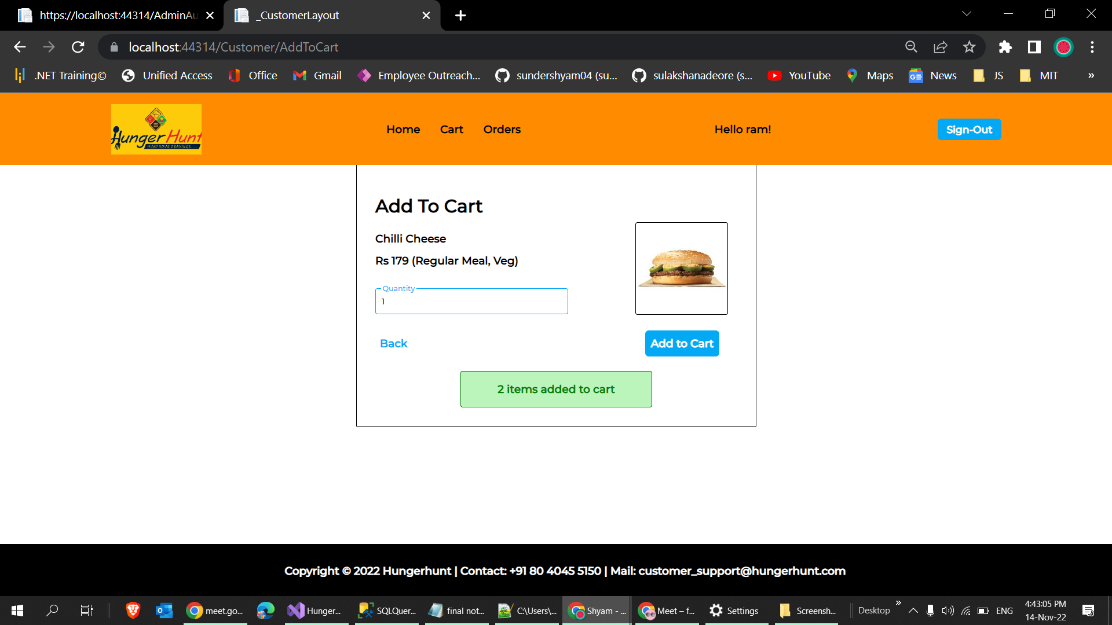

Slide 41
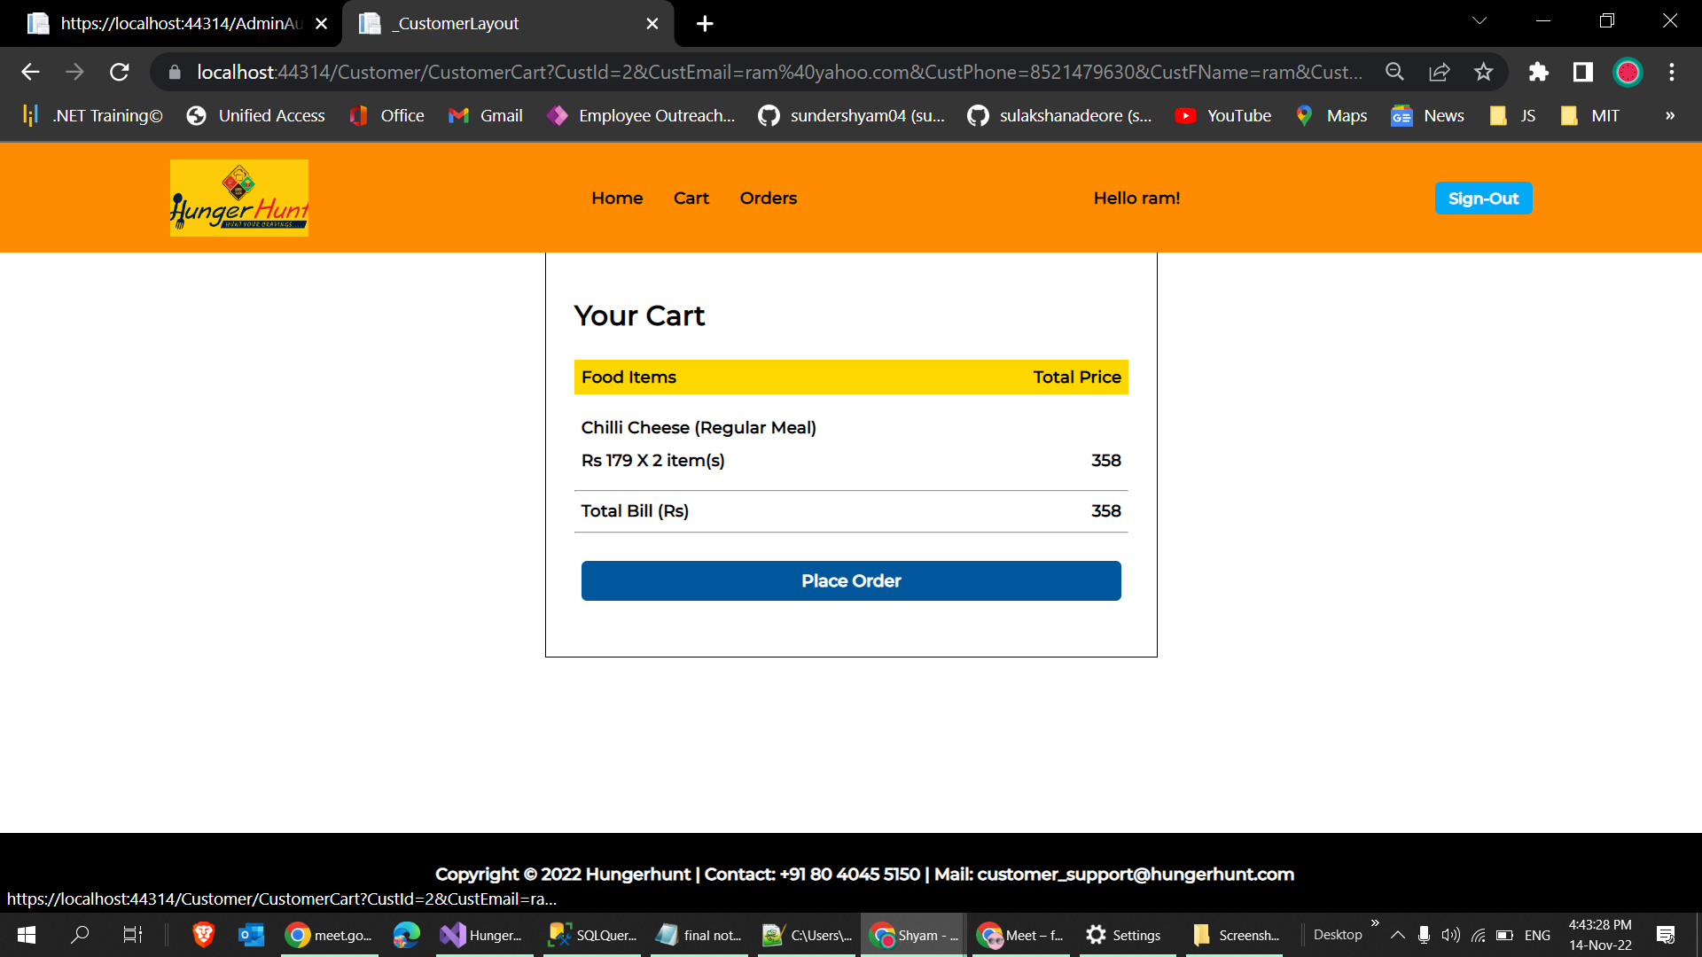
Cart Page

Slide 42
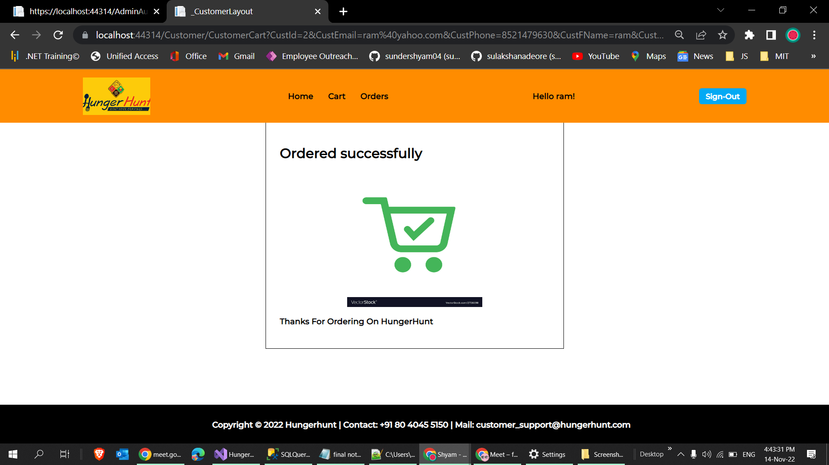

Slide 43
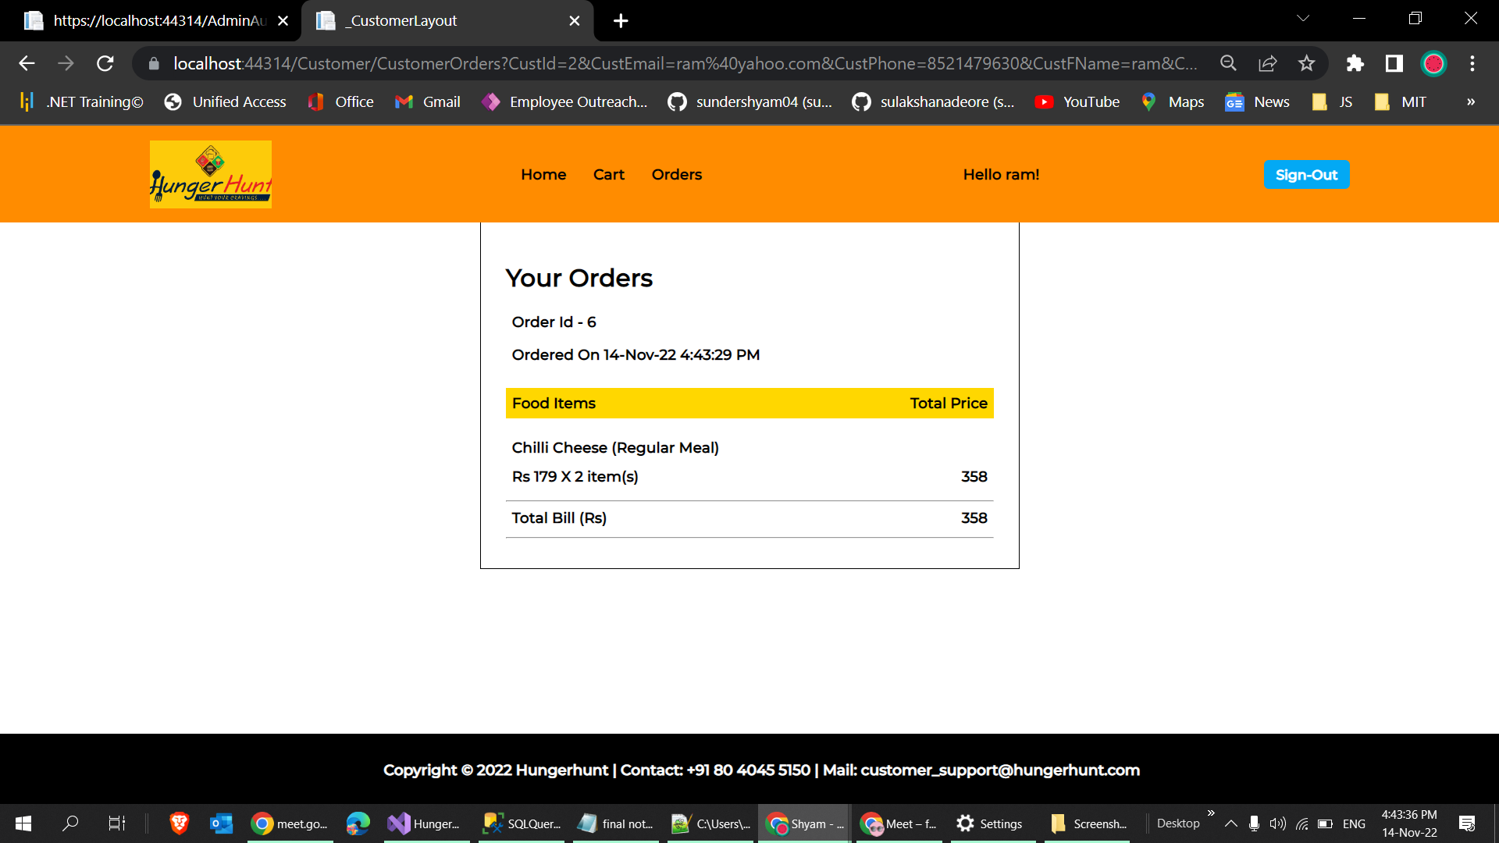
Order Page

Slide 44

Admin Side Login

Slide 45
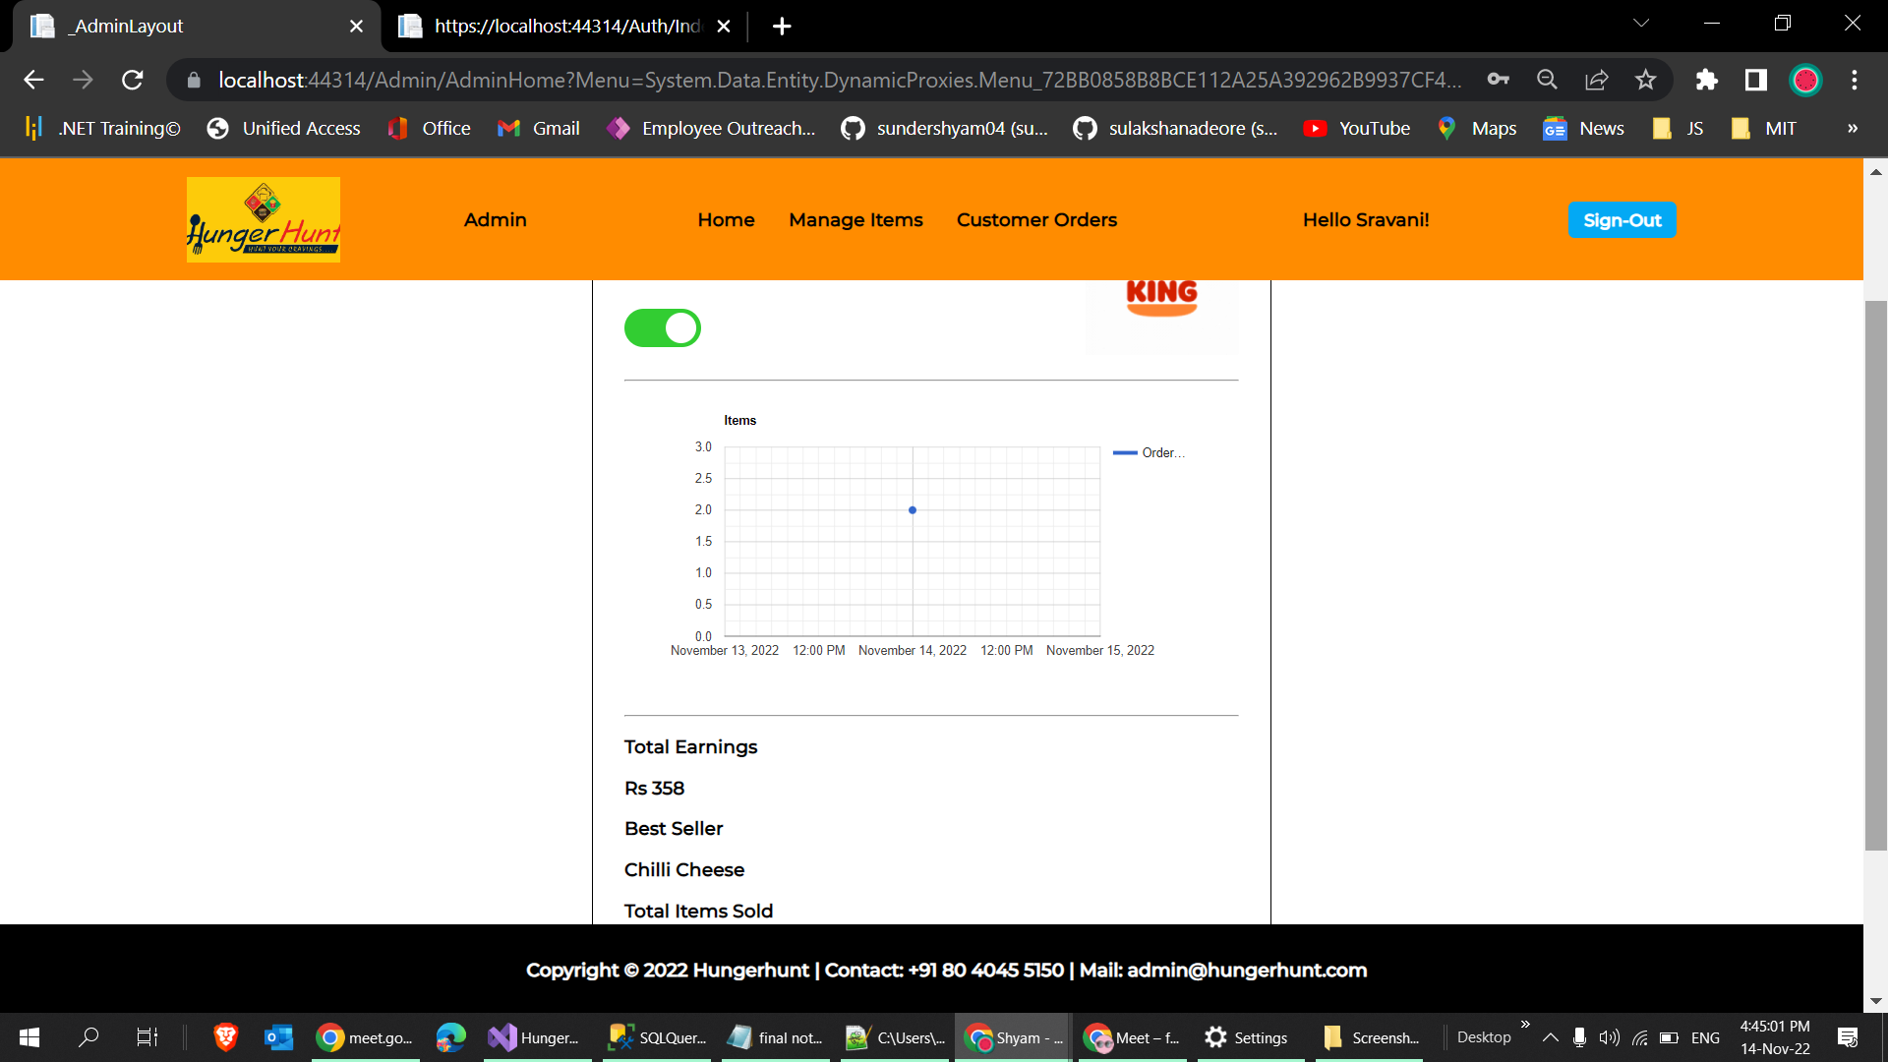
Customer order displayed

Slide 46
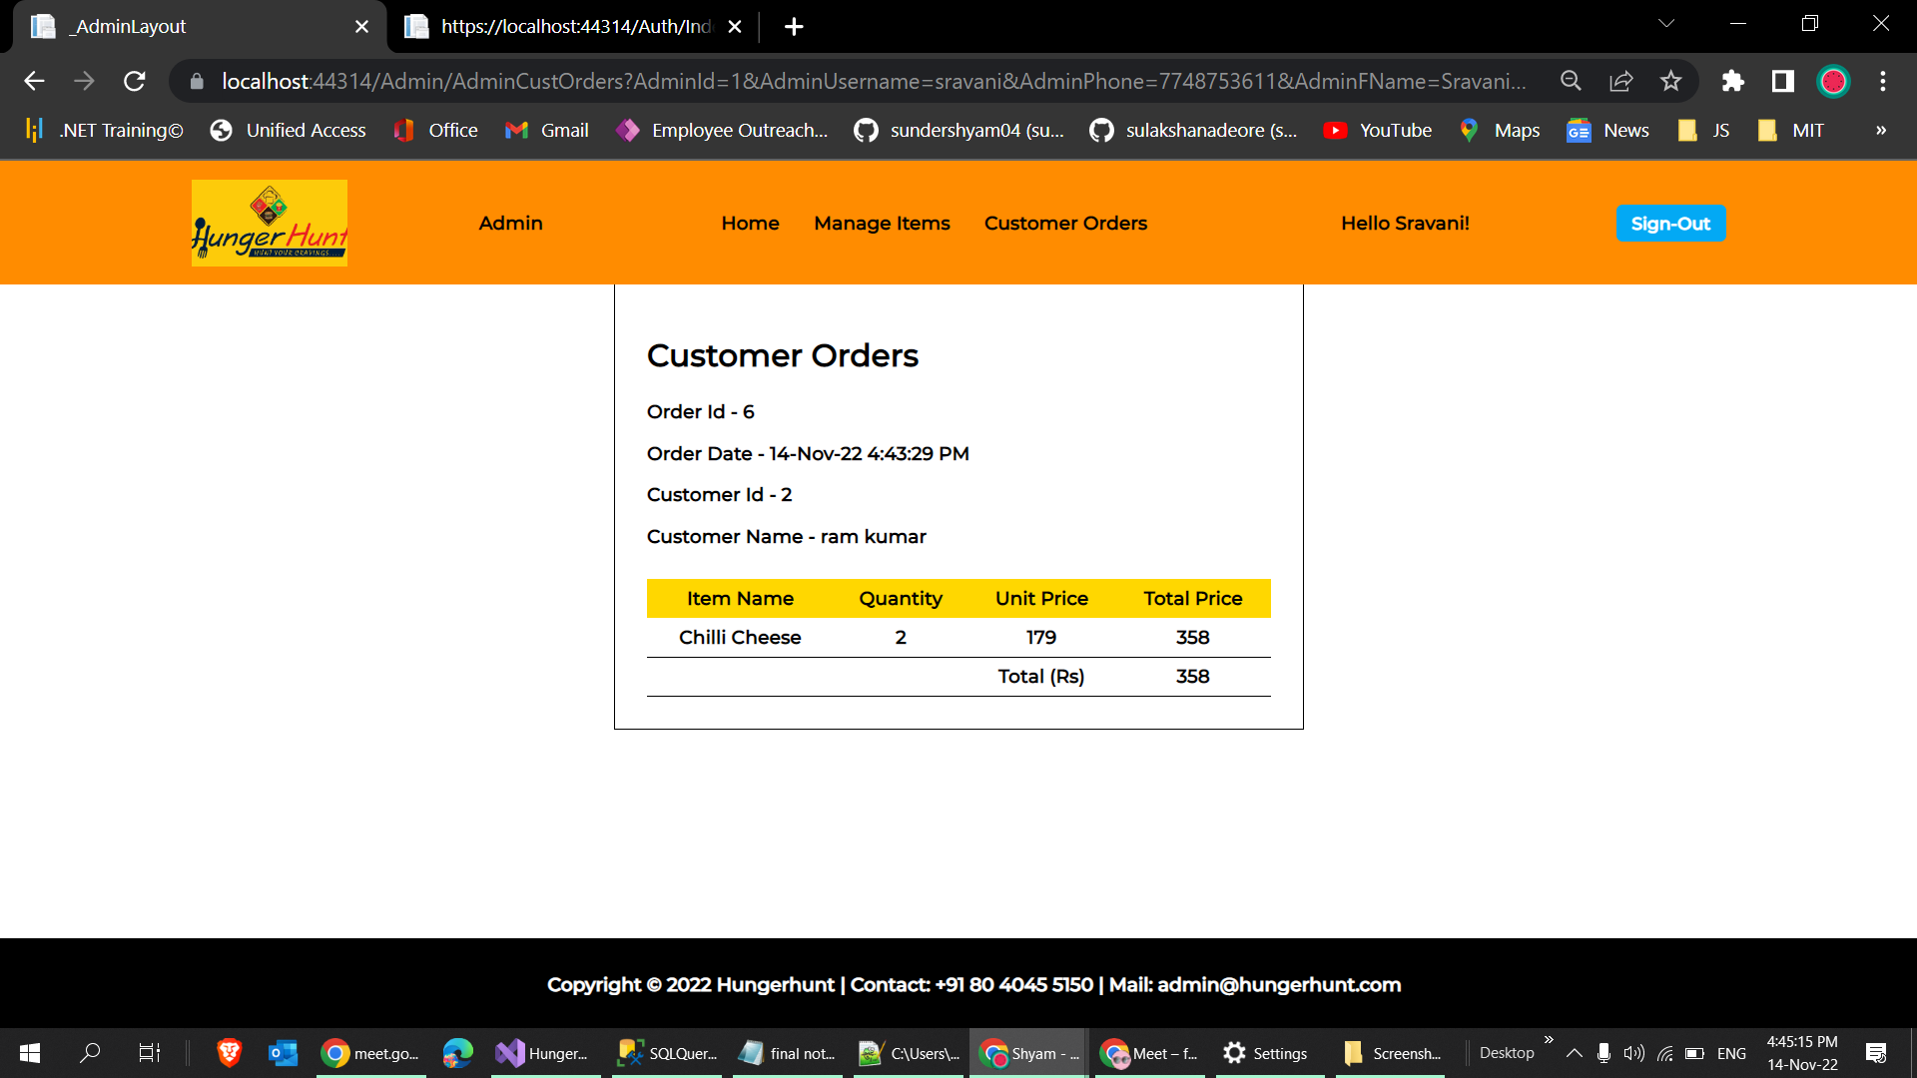
Customer Order Details

Slide 47

Thank You !🙏

